Slide 1

NLP Project: Automated Customer Reviews
Javier Dastas
Jarian Del Valle

Slide 2
Project Objective
Automate customer reviews using NLP techniques
Gain defining data insights
Test traditional ML models for task
Transfer learn pre-trained models from Hugging Face
Dataset: https://www.kaggle.com/datasets/datafiniti/consumer-reviews-of-amazon-products/data

Slide 3
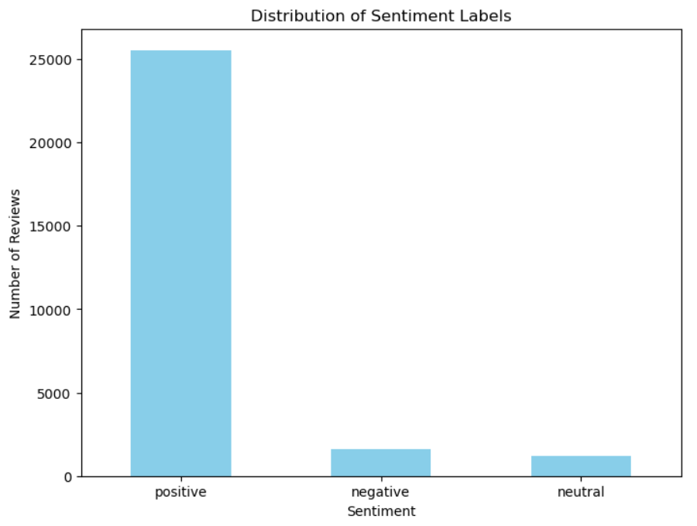
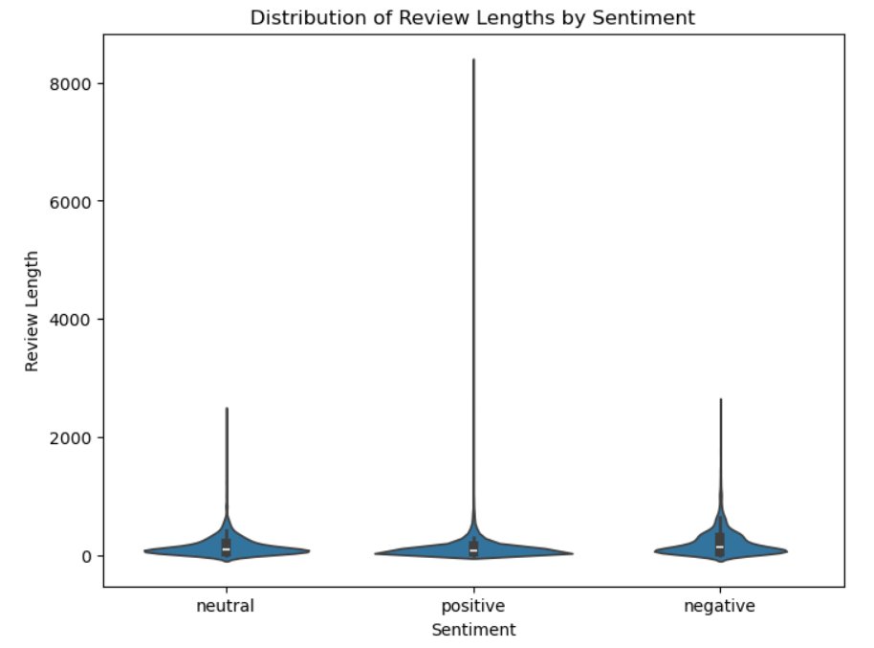
Exploratory Data Analysis
The sentiment classifications are based on rating value feature.

Slide 4
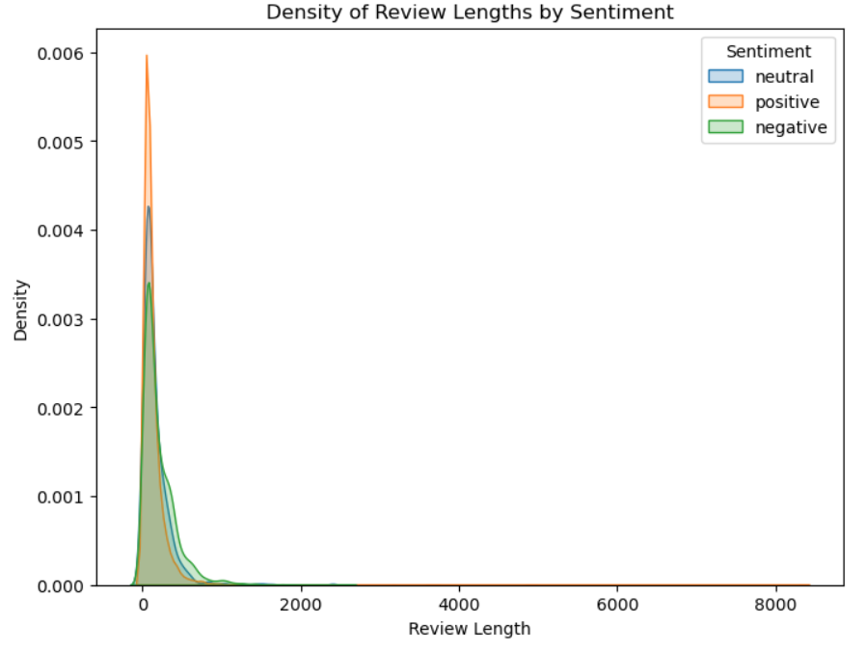
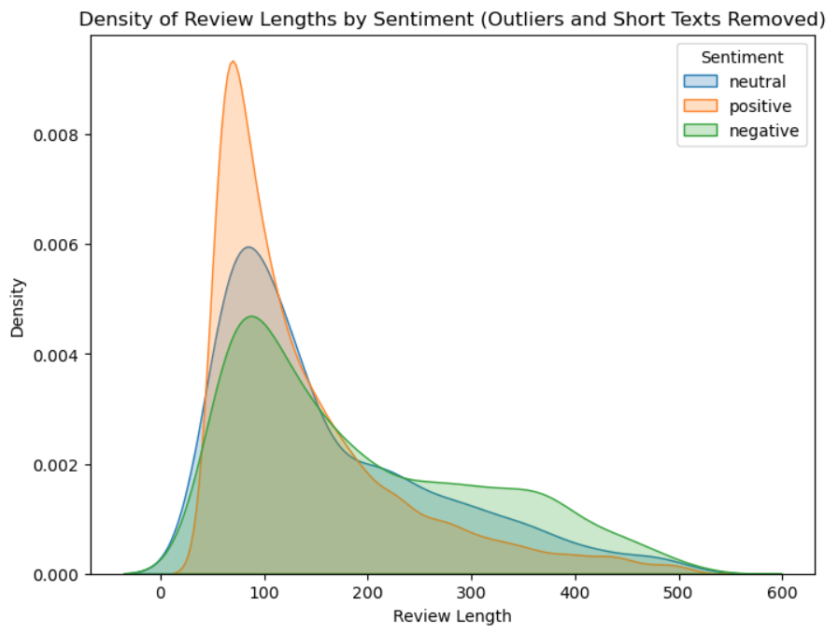
Exploratory Data Analysis
The sentiment classifications are based on rating value feature.

Slide 5
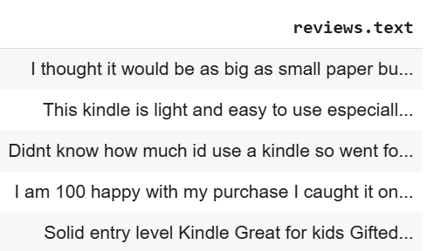
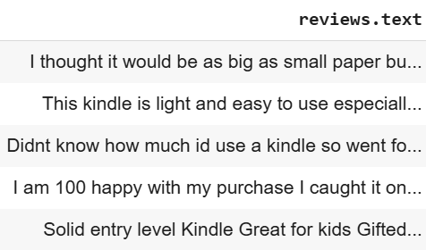
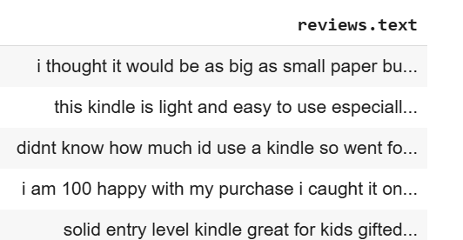
General Data Cleaning
Remove Punctuation
Clean from special syllables
Lower case text

Slide 6
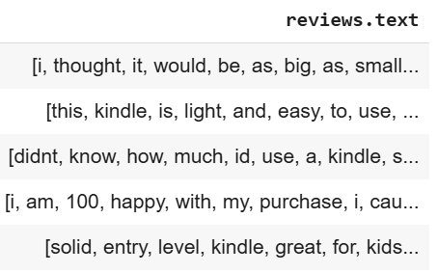
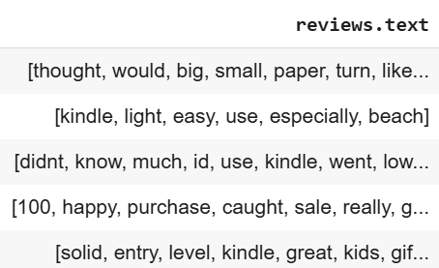
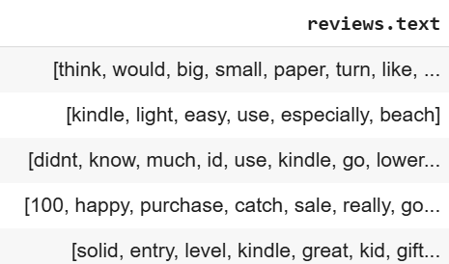
Traditional ML Approach - Data Cleaning
Tokenize text
Remove stop words
Lemmatize text

Slide 7
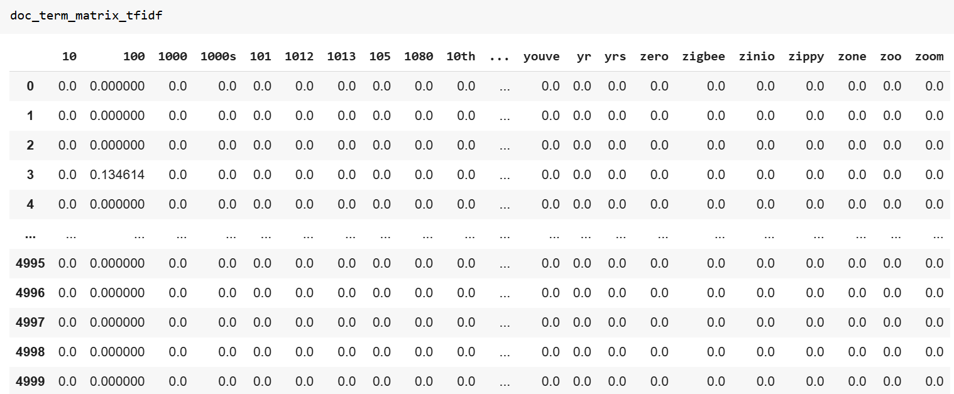
Traditional ML Approach - Data Preparation
TfidfVectorizer

Slide 8
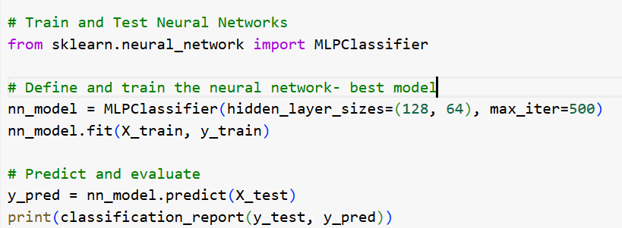
Traditional ML Approach
Pipeline and GridSearchCV- testing multiple traditional models with different hyperparameters
Tested a MLPClassifer Neural Network

Slide 9
Model Evaluation
Model | Best Score | Accuracy on Test Set
Naive-Bayes | 0.75 | 0.76
Logistic Regression | 0.77 | 0.78
Random Forest | 0.85 | 0.87
Neural Network Pre-Trained (MLPClassifier) | 0.86 | 0.86

Slide 10

Model Evaluation

Slide 11
Transformer Approach(Pre-trained model)
Token Size is <= 512 (After the EDA/ETL Process)
Selected Model: DistilBertForSequenceClassification
Use the DistilBert specific Tokenizer: DistilBertTokenizer
Pytorch Optimizer Version: AdamW(model.parameters(), lr=5e-5)
Keep learning-rate weight impact on pre-training model (lr=5e-5)
Use Epochs of 7 with batch_size of 8 for the training.

Slide 12
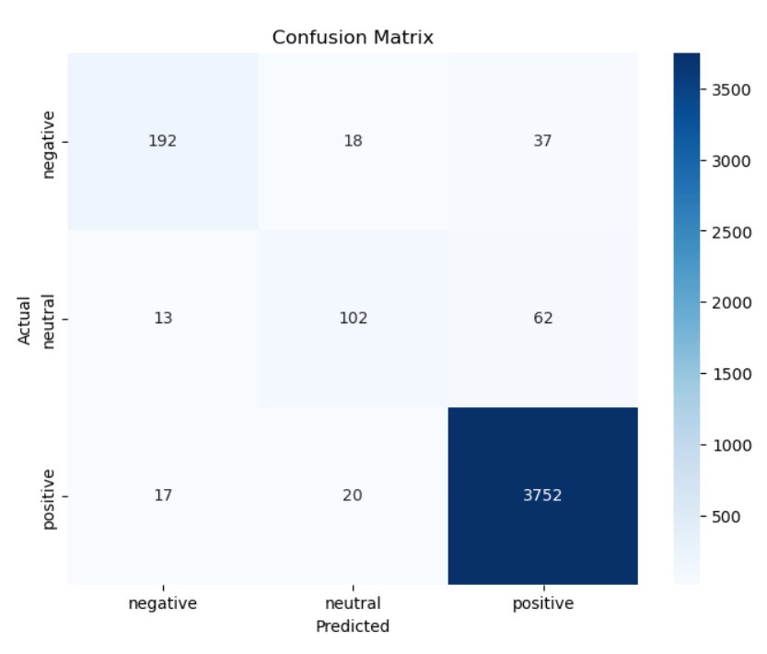
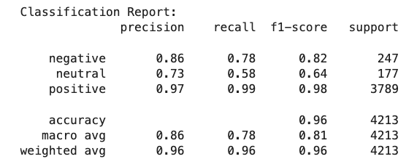
Transformer Approach Evaluation

Slide 13
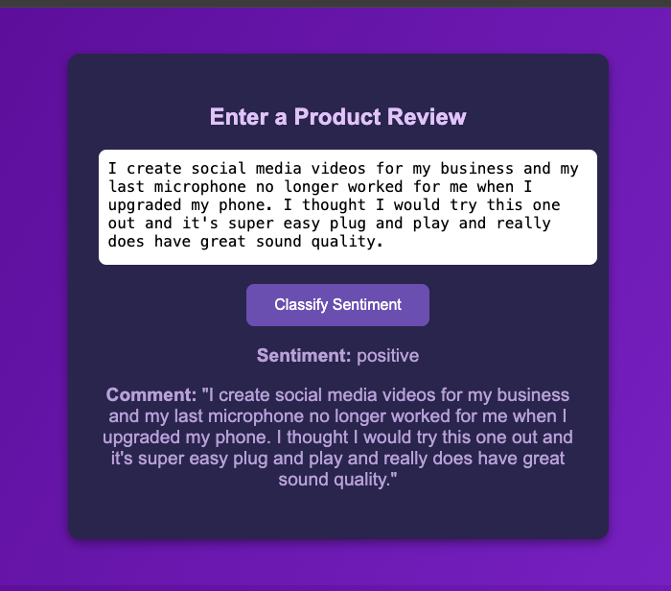
Model Deployment
Web Service Model Deployment
http://dsmlbootcamp.org

Slide 14
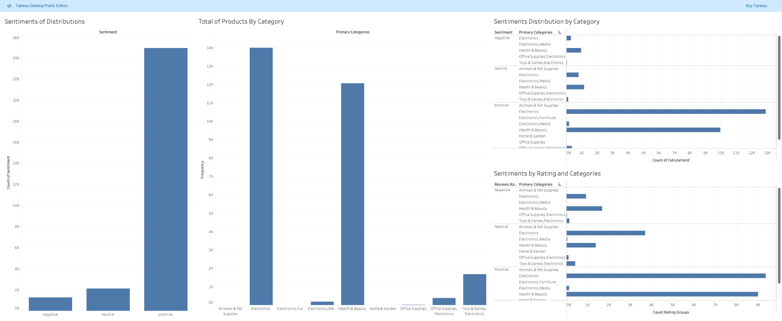
Model Deployment
Tableau Dashboard

Slide 15
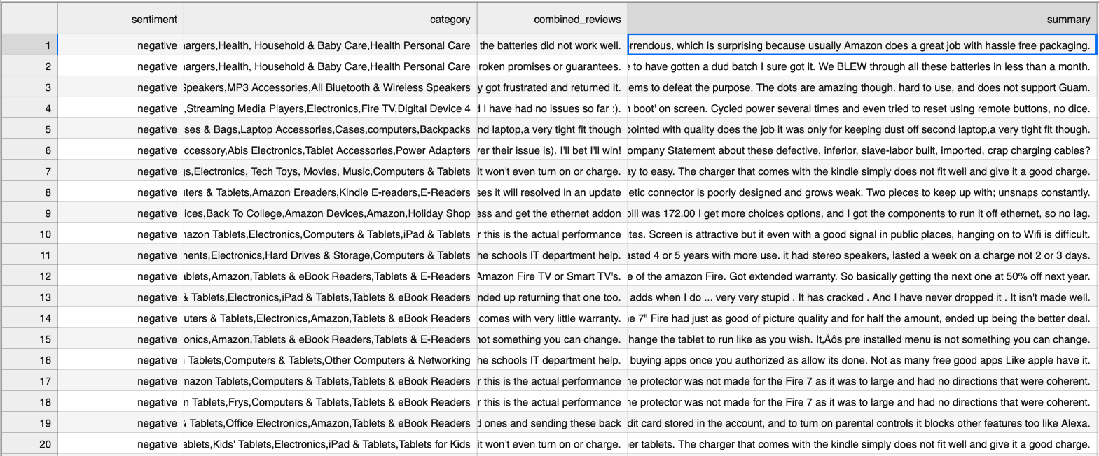
Model Deployment
Generate summaries for each product category using a GenAI
'facebook/bart-large-cnn'

Slide 16
Insights
EDA and preprocessing unlocks meaning
Transformer tokenization impacts performance
More data, better results
Model choice isn’t a one size fits all

Slide 17

THANK YOU
Javier Dastas
Jarian Del Valle

